Slide 1
A Complete Tourism Entertainment App Using AR

Slide 2
PROBLEMS
Digitization is not complete in the field of tourism.
Existing apps are not of much fun.
Existing apps are 100% internet dependent (Which is a problem for tourists in no network areas).
Tourist guides can make mistakes.
Tourists are heavily insecure on depending others.

Slide 3
Advantages of our App
75% internet independent
Makes tourists fell secure as no need of depending on others.
No language barrier
Fun to use due to the implementation of AR

Slide 4
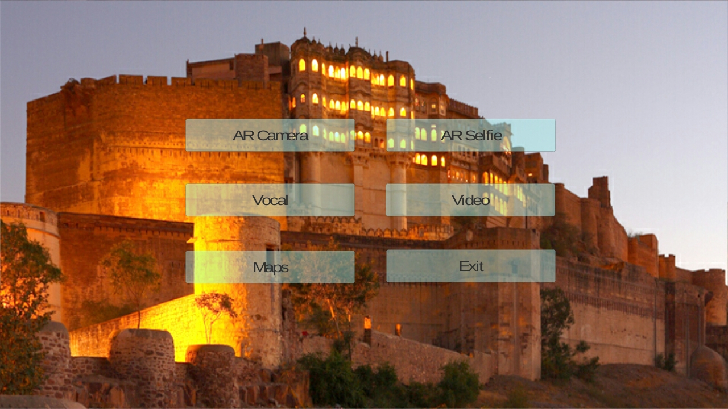
APP : AR RAJASTHAN

Slide 5
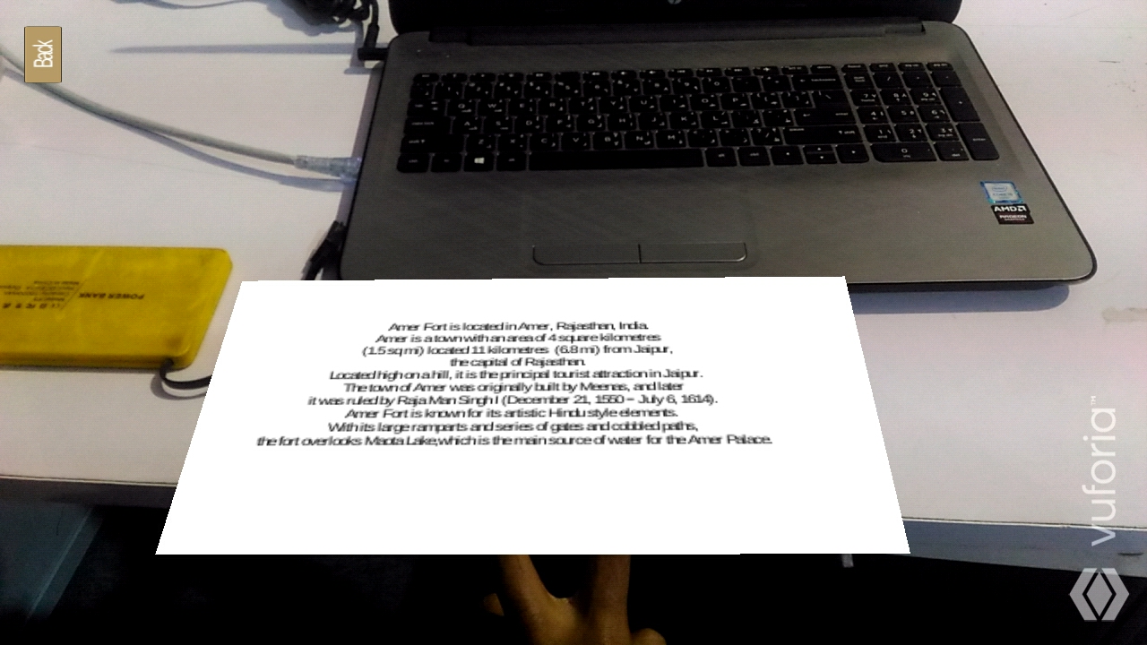
AR CAMERA

Slide 6
In the existing system for descriptions near monuments huge flex boards are kept which is a environmental hazard.
The language used for description is generally a problem for foreign visitors.
In our app AR RAJASTHAN an image will be kept near the monuments which when scanned will provide the information of the monument.

Slide 7
In the image shown a below a 100 rupees note was shown to camera to get the description of Amer Fort.
In this app languages can be translated by using AR Text Recognition which is a huge help for foreigners.
(NB: Not included in the prototype)

Slide 8
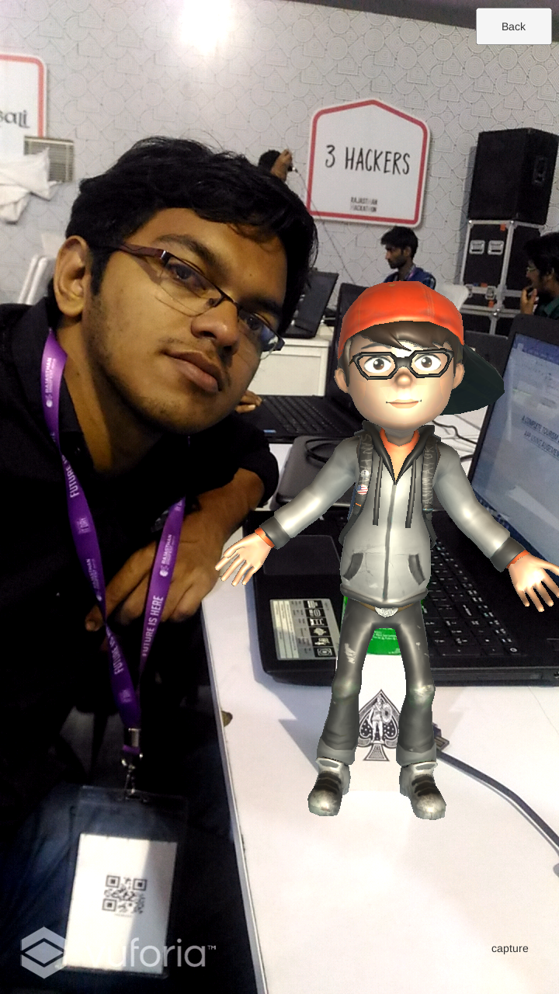
AR SELFIE

Slide 9
Taj Mahal was build by Shajahan.
Just think of an opportunity to take a selfie with Shahjahan. That’s what we have made possible through AR Selfie.
In the above picture an Ace card was used to stimulate a 3 Dimentional image of a Model.
The same can be done with a designed Shahjahan or Akbar.
This can of great fun to Tourists.

Slide 10
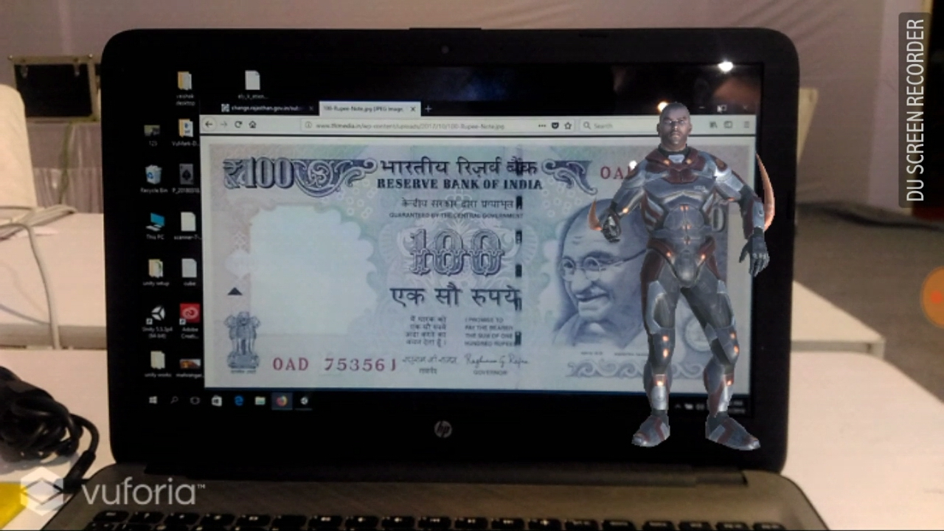
Vocal

Slide 11
When you go to a tourist place usually guides give us instructions
But that can be eliminated using our App
When you go to a tourist place a picture will be provided. When the picture is scanned using the app An animated characher will give the descriptions on the tourist place.
In the above picture a 100 rupees note was used to generate the animated character.

Slide 12
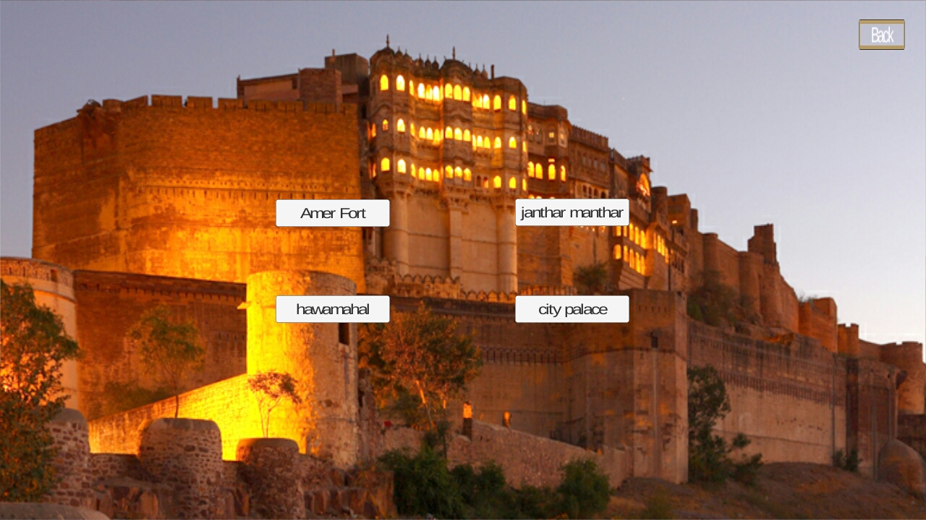
Maps

Slide 13
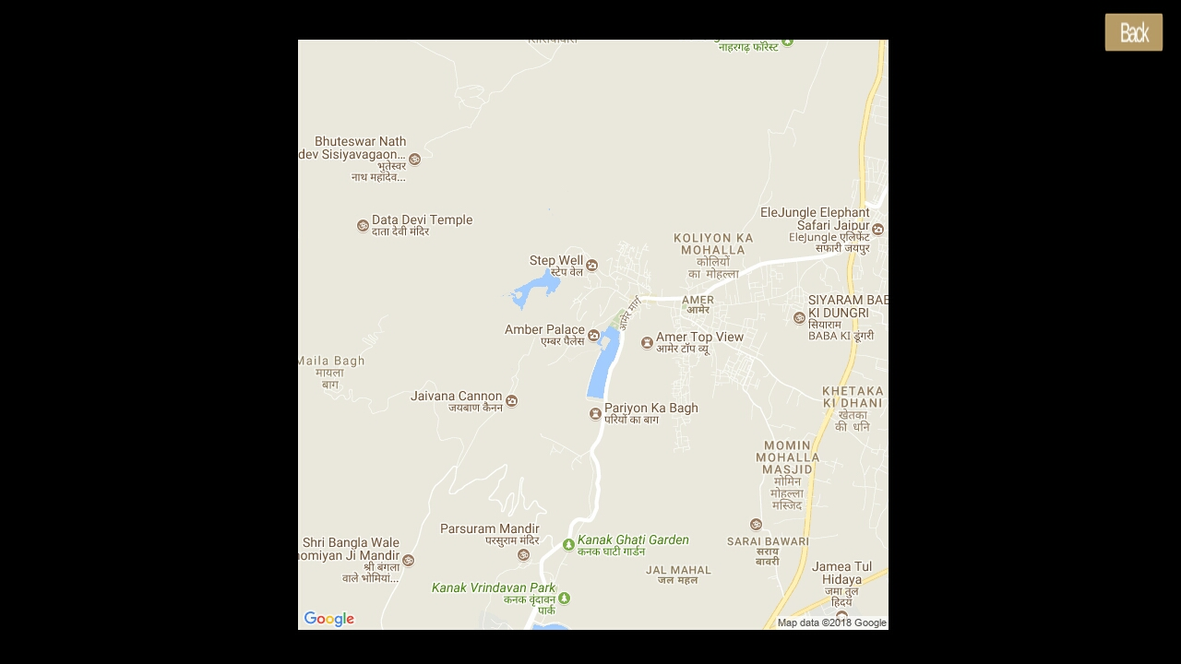

Slide 14
The Maps of different tourist places can be obtained using the map.
In the above picture the image of places surrounding Amber Palace.

Slide 15
Video
With the help of AR Camera we wil be able to obtain video description of various places.

Slide 16
Applications Used
Unity
Vuforia
Mixamo
Photoshop

